Slide 1
EEE 335 Principles of Operating Systems
File System
(Modern Operating Systems 4.1 – 4.3)

Slide 2
Quick Review
What are the advantages of segmentation?
What are two disadvantages of pure segmentation?
Notes:
Advantages:
Easy to link programs together
May be easier to grow/shrink segments
Protection can by assigned to memory by its purpose
Code is more easily shared between processes
Disadvantages:
Segments larger than physical memory cannot be loaded
Memory will become fragmented over time
Programmer must be aware of the model

Slide 3
Outline
A case for file systems
The file abstraction
Description of file systems
Implementation of file systems
Naming
Structure
Type
Attributes
Directory
Operations

Slide 4
A case for file systems
Processes create information
This information is sometimes:
Large
Persistent
Shared
Protected
Notes:
Why we need a file system? .. Processes store and retrieve information. It could be large, persistant, shared, or protected. The solution to these issues is to separate information from processes itself. This is done by introducing file systems.

Slide 5
A case for file systems
Let’s say we can now save directly on the hard drive. We run into some issues to:
Find data
Protect data
Save data
Notes:
This is an example of a file case. What we need from a file system? .. Find data, Protect data, Save data.

Slide 6
The File Abstraction
To hide these issues from the user we use a new abstraction: the file
File: A persistent logical information unit created by a process.
The idea is:
Create a named information unit
That unit continues to exit when the process terminates
Can be found by name
Notes:
This is simply what the file is

Slide 7
Description - Naming
Naming Convention
Length
Case sensitivity
Extension
What is maximum path name for Windows 10?
For linux?
What about case sensitivity:
In Windows?
In Linux?
What about extensions:
In Windows?
In Linux?
Notes:
C:/256+1
1 +2 + 256 + 1
Win 10: 260
Linux - Linux has a maximum filename length of 255 characters for most filesystems (including EXT4), and a maximum path of 4096 characters

Slide 8
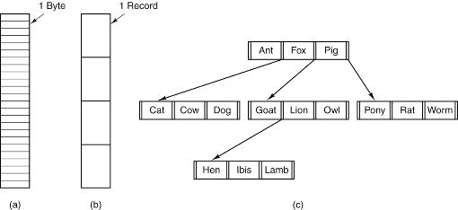
Description – File Structure
File Structure
Unstructured
Records
Tree
Notes:
Unstructured byte sequences offers most flexibility – all versions of Linux, OS X, Windows use this
A structure of fixed length records – each with some internal structure.
A tree of records, not necessarily all one length Each record contains a key field

Slide 9
Description – File Type
Type
Regular
ASCII
Binary
Portable Executable or PE Format (Windows)
Executable and Linkable Format or ELF (Linux)
Directories
Character Special (linux)
Used to model serial I/O devices
Block Special (linux)
Use to model disk storage
Notes:
Character Special files Model serial IO devices such as terminals, printers or networks.
Block Special files model the Disk Operations.

Slide 10
Description - Attributes
Attributes (metadata)
Protection
Creator
Owner
Creation date
Modification date
etc.
Different ways to link the file to the attributes
Directly in the file
A separate file (i-nodes)

Slide 11

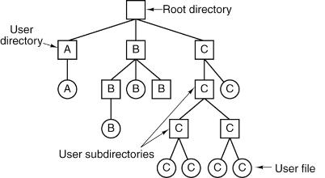
Description - Directory
Directory
Structure
Single level
Hierarchical
Naming
Relative path
Absolute path
Special files (dot, dotdot)
Notes:
Single-level: simple to locate files since they are located in the same location. Often used for simple embedded devices and was used in the first PCs.
Hierarchical: Tree of directories, more structured and easier to search. Easier to manage sharing and protection.

Slide 12
Description - Operations
Operations
Create
Delete
Open
Close
Read
Write
Rename
etc.

Slide 13
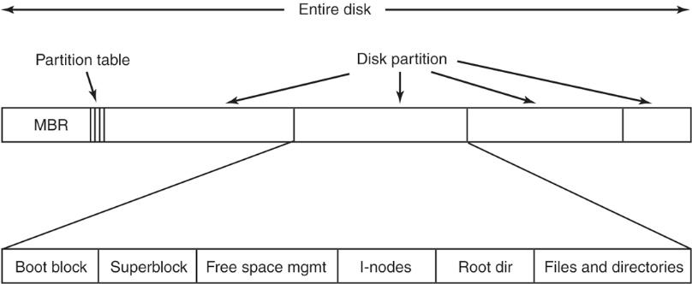
Implementation of file systems
Layout overview
Notes:
Boot block : for computer booting
Superblock : key parameters and information about file system (blocks, block size,……, etc)
I-nodes : array of data structures per file
The MBR, and thus the partition table, is stored in the boot sector, which is the first physical sector of a HDD. The MBR reads the partition table to determine which partition is the active partition. The active partition is the partition that contains the operating system that a computer attempts to load into memory by default when it is booted or rebooted.
Boot Block: instructions to start the OS
Superblock: Contains the information about the file system (block size, type, list of i-nodes, etc.)
Free space management: indicates the free blocs
I-nodes: Contains the information about the files (address, size, creation date, protection, status, etc.)
Root directory: the start of the file system.
Directories and files: the rest of the directories and files hierarchy (most of the partition space).

Slide 14
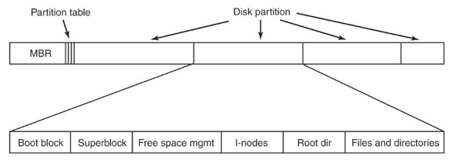
Implementation of file systems
Partition workflow
BIOS reads the Master Boot Record (MBR);
MBR finds the active partition;
Reads the first block and executes it; and
The boot block code starts the OS.
Layout of the file system
Boot Block: instructions to start the OS
Superblock: Contains the information about the file system (block size, type, list of i-nodes, etc.)
Notes:
Basic input/output system

Slide 15
Implementation of file systems
Layout of the file system (continued)
Free space management: indicates the free blocs
I-nodes: Contains the information about the files (address, size, creation date, protection, status, etc.)
Root directory: the start of the file system.
Directories and files: the rest of the directories and files hierarchy (most of the partition space).

Slide 16
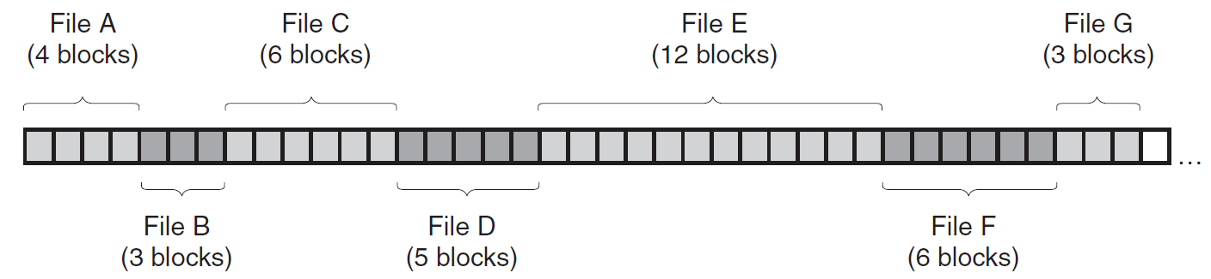
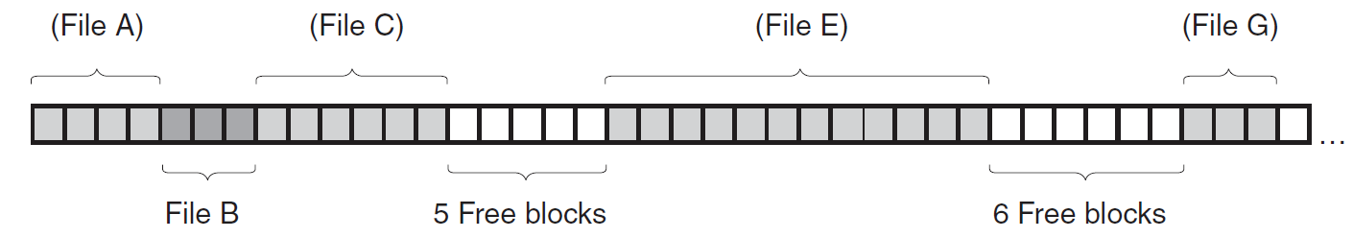
Implementation of file systems
File implementation
Continuous allocation
Advantages:
simple (start address and length)
Disadvantages:
Fragmentation
Notes:
How the OS will know which block on the HD belongs to which file.

Slide 17
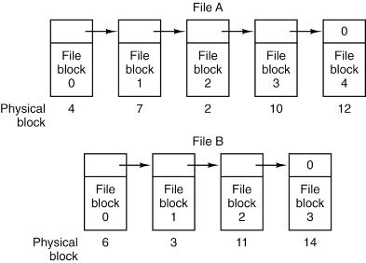
Implementation of file systems
File implementation
Linked list
Advantages:
no fragmentation
Disadvantages:
Random access is slow
Pointers take block space

Slide 18
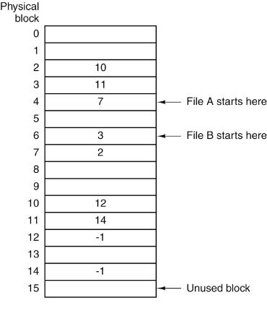
Implementation of file systems
File implementation
Linked list using a table in memory (File Allocation Table)
Advantages:
no space loss for pointers
easier to do random access
Disadvantages:
Table can be huge
File A – Blocks 4,7,2,10,12
File B – Blocks 6,3,11,14
-1 indicates the end of the chain

Slide 19
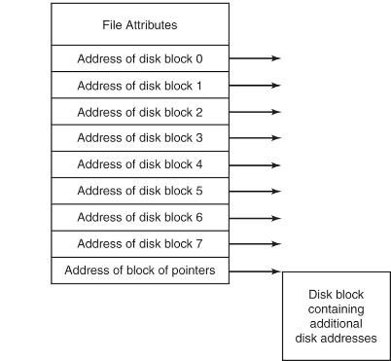
Implementation of file systems
File implementation
I-nodes (index nodes), which lists the attributes and disk addresses of the files blocks
Advantages:
Only in memory when a file is open
Active i-node table related to the number of open files
Disadvantages:
Fixed number of block addresses
Notes:
Big advantage is space. It is similar to the inverted page table.
Mode/permission (protection)
Owner ID
Group ID
Size of file
Number of hard links to the file
Time last accessed
Time last modified
Time inode last modified

Slide 20
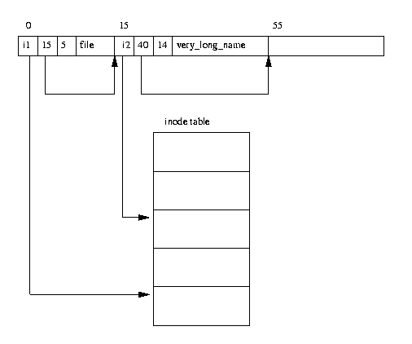
Implementation of file systems
Directory implementation
Directory entry list
Directory entry for file has a reference to inode 1
Directory Entry Length – length of this directory entry in bytes
Name Length – length of the file name
source: https://www.tldp.org/LDP/tlk/fs/filesystem.html

Slide 21
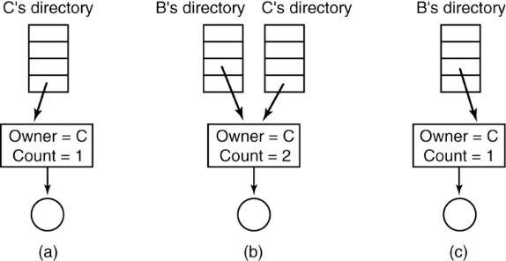
Implementation of file systems
File sharing
Option 1: hard links
Option 2: symbolic links
Notes:
The big squares are the content of the i-node.

Slide 22
File Allocation Table (FAT))
Evolution of the FAT file system
Original 8-bit FAT (1977)
Developed by Microsoft (Bill Gates and Marc McDonald) for the Alter BASIC interpreter
Nine character file name (6.3)
Cluster address were 8-bit long (256 clusters)
FAT12 (1980)
Developed by Microsoft mainly for floppy disks
Used by Microsoft QDOS, 86-DOS, PC-DOS and MS-DOS
Cluster address were 12-bit long (4096 clusters), disk size stored as a 16-bit count of sectors (16MB max size with 4KB clusters, 32MB max size with 8KB clusters)
FAT16 (1984)
IBM releases the PC AT with a 20MB disk
Microsoft releases PC-DOS 3.0 and MS-DOS 3.0 with FAT16
Cluster address were 16-bit long (4096 clusters)
Max disk size of 4GB
FAT32 (1996)
Released with Windows 95 OSR2 (OEM service release)
32-bit cluster addresses (28 bits used, so max 2²⁸ clusters)
8TB max volume size with 32KB clusters (often limited to 32GB by OS or 2TB by MBR)
4GB max file size (limited by file length entry in bytes)
File name still limited to 8.3 format
Can be extended to 255 chars (LFN for Long Filename) by the OS using VFAT ( Virtual FAT)
Nowadays, often used for flash cards and USB thumb drives
Supported by all Windows and UNIX varieties
*This section on FAT file systems based on excerpts from Dr. Roberge’s EE547 Digital Forensics Course

Slide 23
Basic Concepts
Quite simple
Two main data structures
Directory Entries
File Allocation Table (FAT)
File and directory contents are stored in clusters
Sector is the smallest physical storage unit on the disk (512B)
Cluster is the smallest allocation unit of the file system
Group of 2^{n} consecutive sectors (i.e. 1, 2, 4, 8, …)
A directory entry contains
File name
File size
Starting cluster of the content
Other metadata
The File Allocation Table is used to find the next cluster of a file until the end of file (EOF or 0xFFFF) is reached

Slide 24
Basic Concept
Essential vs Non-essential data
Essential: data needed to save and retrieve files (ex.: content location)
Non-essential: data provided for convenience, but not needed for basic functionality (ex.: creating time)
Endianness
Sequential order of the bytes when interpreting numeric values that covers multiple bytes
The name was nailed an article written in 1980 by Danny Cohen based on the satire Gulliver’s Travels when they discuss which end is the best when cracking an egg
Little endian: least significant byte in the lowest address
Intel and many other microprocessor
Big endian: most significant byte in the highest address
IPv4, IPv6, TCP, UDP
Applies to numeric values
Integer, floating point, Unicode characters,

Slide 25
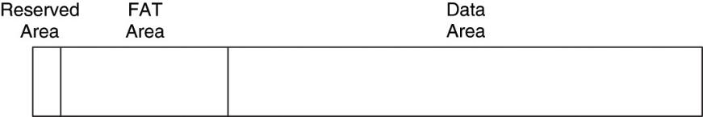
FAT File System Structure
Layout of the FAT file system is divided in 3 areas
Reserved area: data describe the file system structure
Boot sector at sector 0
File system information sector (FSINFO, FAT32 only)
FAT area: primary and backup FAT structures
Number of FAT structure specified in the boot sector
Data area: clusters used to store file and directory content
Starts with cluster #2 (so clusters 0 and 1 do not exist)
Source: Carrier, 2005

Slide 26
Boot Sector
The boot sector is located in the first sector
Contains the bulk of the file system category data
[0-2] Jump to boot code
[3-10] OEM name in ASCII
[11-12] Bytes per sector
[13-13] Sectors per cluster (powers of 2 and smaller than 32KB)
[14-15] Size in sectors of the reserved area
[16-16] Number of FAT structure, typically 2
[17-18] Maximum number of entries in root directory
[19-20] 16-bit value of number of sectors in file system
[21-21] Media type (0xf8 for fixed disks and 0xf0 for removable)
[22-23] 16-bit size in sectors of each FAT (FAT12/16 only, 0 for FAT32)
[24-25] Sectors per track
[26-27] Number of heads
[28-31] Number of sectors before start of partition
[32-35] 32-bit value of number of sectors in file system (either this value or the 16-bit value must be 0)
Other fields in bytes [36-61] for FAT12/16 and [36-89] for FAT32
Boot code follows
[510-511] Signature value 0xAA55

Slide 27

Boot Sector
From the Boot sector, get
Sector size (bytes)
Cluster size (sectors)
Number of sectors in file system
Number of FATs
Size of each FAT (sectors)
Size of reserved area (sectors)
Maximum number of entries in root directory
Cluster of root directory (FAT32)
Cluster of FSINFO (FAT32)
Source: Carrier, 2005

Slide 28
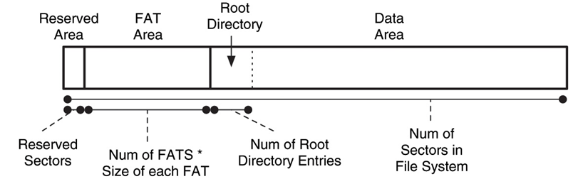
FAT16
Start of cluster 2
Source: Carrier, 2005

Slide 29
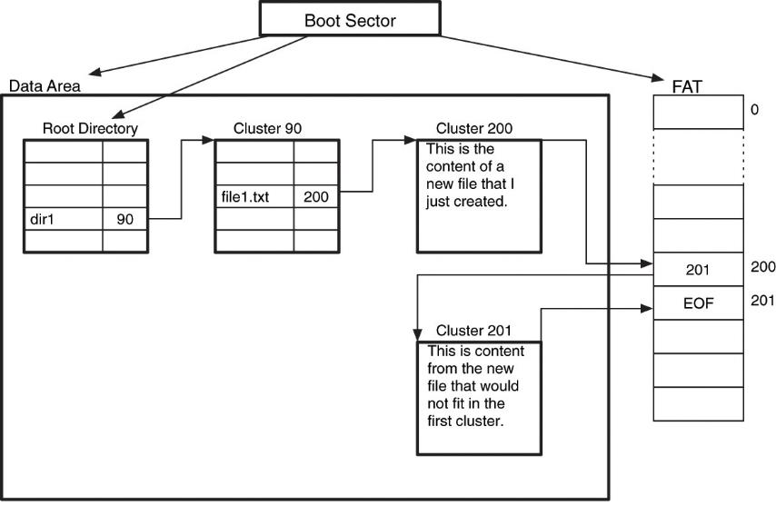
FAT16 Organization

Slide 30
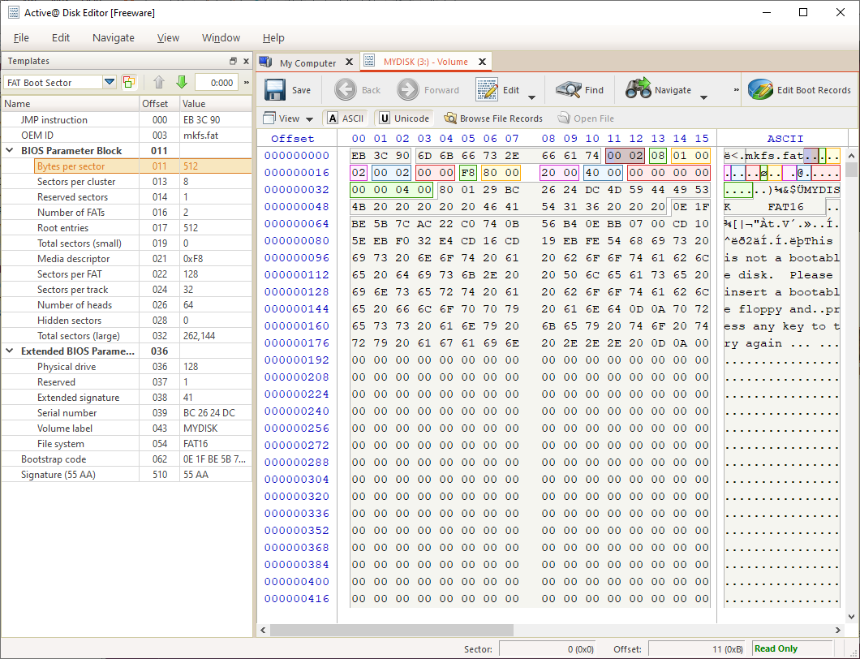

Slide 31
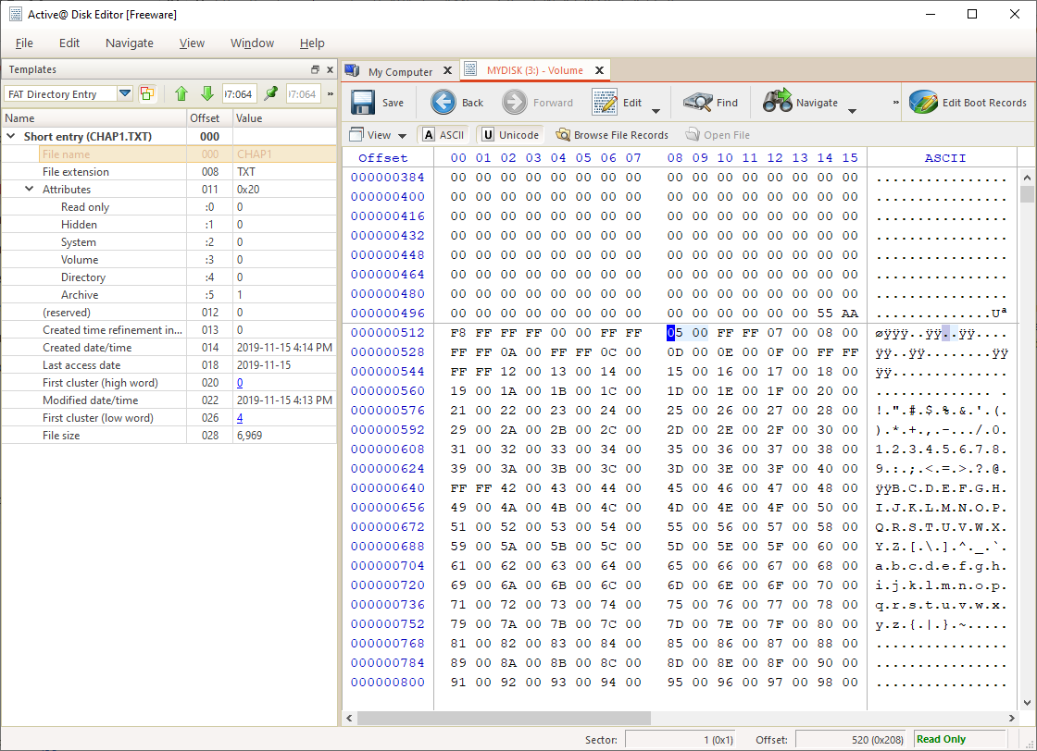

Slide 32
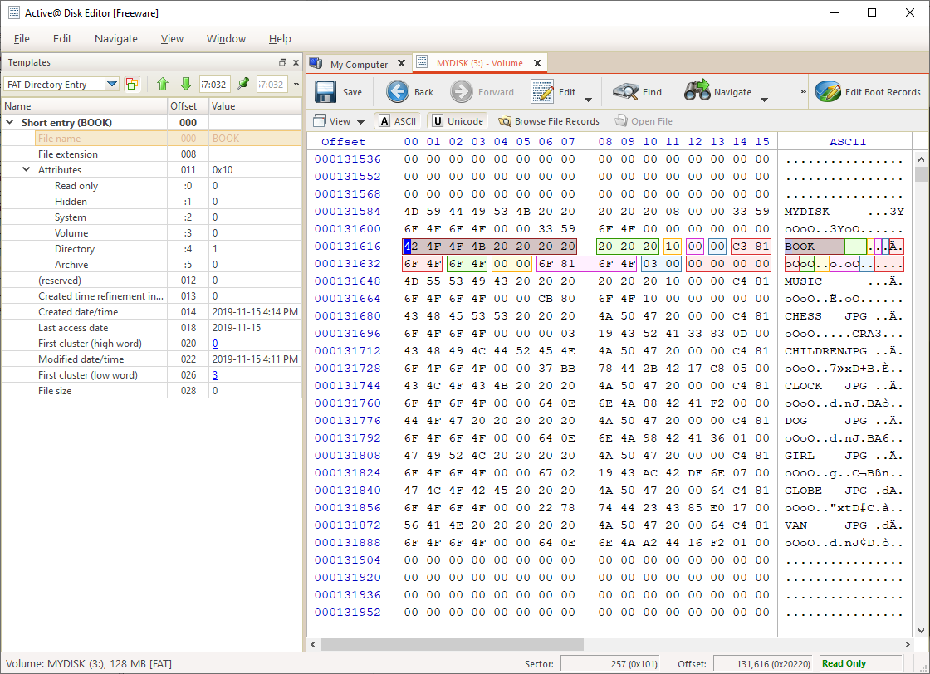

Slide 33
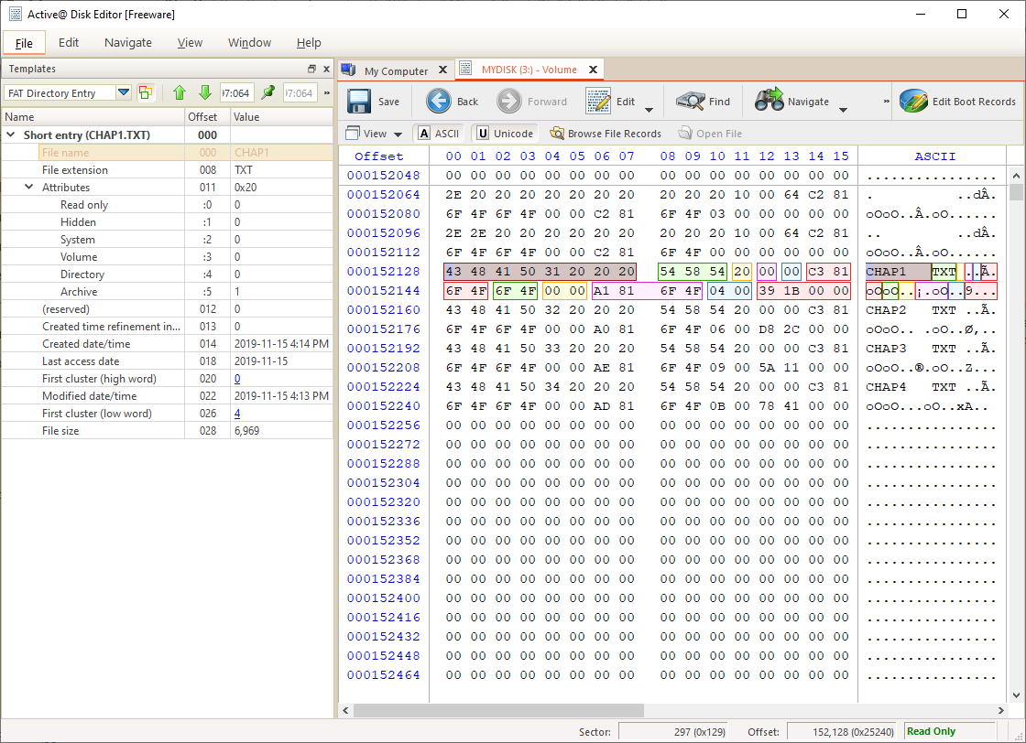

Slide 34
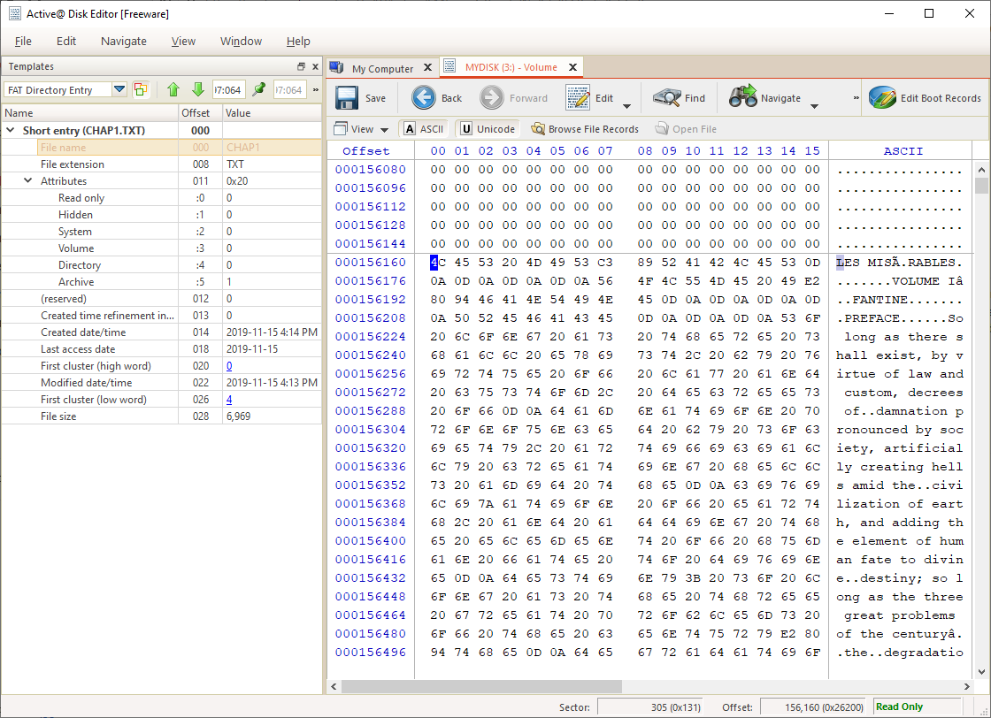

Slide 35
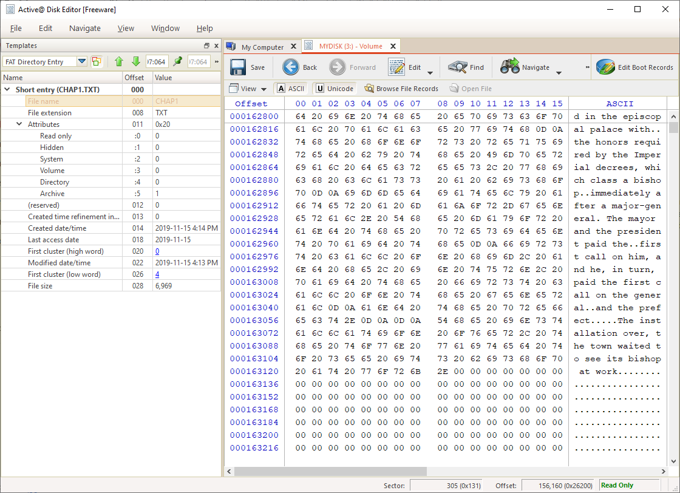

Slide 36
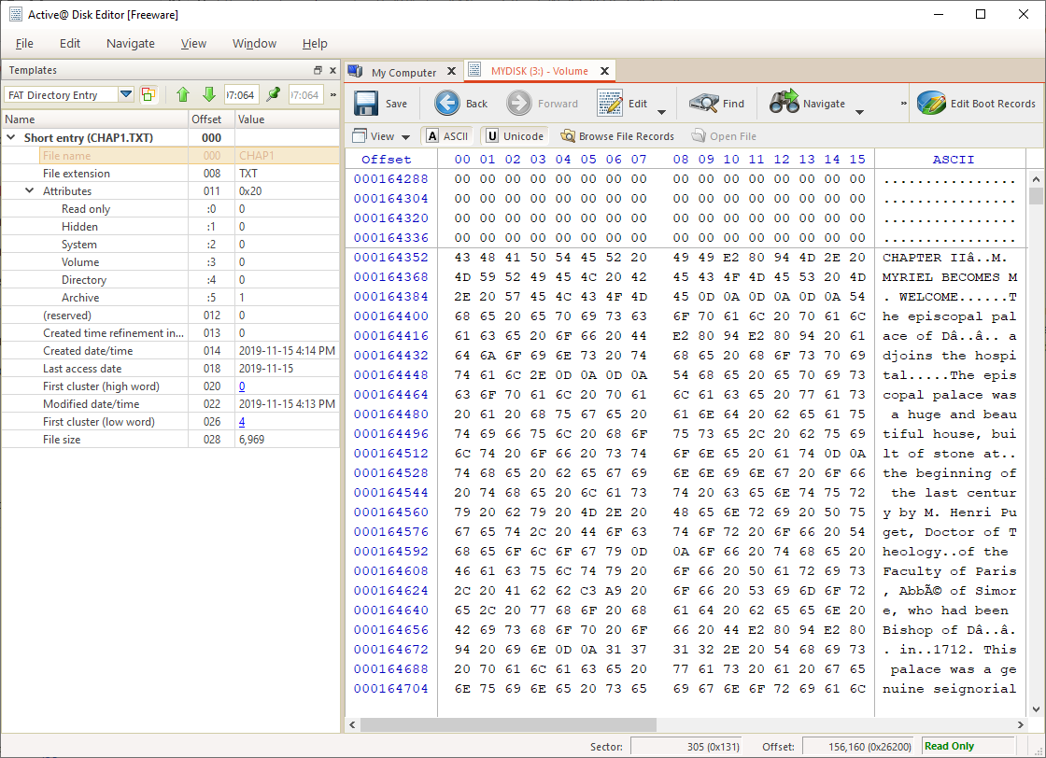

Slide 37
Questions?

